Slide 1

TripPlanner: Custom Travel
Itineraries Made Easy
Siddhant Gaikwad 22104083
Sekhar Gauda 22104044
Harsh Gajera 22104099
Paresh Gupta 22104089
Project Guide
Ms. Apeksha Mohite

Slide 2
Contents
Suggestions in Review 1
Introduction
Objectives
Scope
Literature Survey
Features / Functionality
Technology Stack
Block Diagram
Use Case
Result and Discussion
Conclusion and Future Scope
References

Slide 3
1. Introduction
Problem Identified :
Solution Proposed :
Travelers often struggle to find unique, lesser-known destinations beyond popular spots. Current platforms focus on well-known locations, limiting diverse experiences and complicating content management and booking.
TripPlanner provides a platform highlighting hidden gems, helping travelers discover unique spots, enrich their experiences, and simplify travel planning. By focusing on lesser-known places and improving content management, TripPlanner offers a personalized and enjoyable travel experience.

Slide 4
2. Objectives
To make it easy for travellers to discover unique and lesser-known places.
To provide useful information and tips to enhance travellers’ experiences at these special spots.
To allow developers to easily add, update, and manage information about locations.
To allow users to suggest new places and give feedback to continuously improve the site.
To incorporate multimedia content, such as photos and videos, to give travellers a preview of destinations.

Slide 5
3. Scope
This project will be able to build an easy-to-use website that highlights lesser-known spots and hidden gems.
This project will produce a website which is easy to navigate and has an interactive GUI.
It will have detailed information about each hidden gem, including descriptions, photos, and useful details.
This project will be able to expand the site with more hidden gems and interesting blogs.
This website will be able to gather and use feedback from users to continuously improve the site

Slide 6
4. Literature Survey
Sr. No. | Title | Author(s) | Year of Publication | Key Findings
1. | Social Media and Tourism : The Use of UGC in Travel Decision Making. | A. Fotis, D. Buhalis, N. Rossides | 2022 | User-Generated Content (UGC) significantly influences travelers' decision-making processes. Social media platforms enhance travelers' access to peer reviews and recommendations.
2. | The Role of Mobile Technology in Travel Planning | J. Wang, D. Xiang, X. Zhang | 2020 | Mobile devices improve real-time travel planning by offering flexibility and convenience. Integration of location-based services enhances the personalization of travel itineraries.

Slide 7
4. Literature Survey
Sr. No. | Title | Author(s) | Year of Publication | Key Findings
3. | Personalization of Online Travel Services : The Impact on User Experience. | K. Staab, H. Werthner | 2020 | Personalized recommendations enhance user satisfaction and loyalty to travel platforms. Customization reduces information overload and improves decision-making efficiency.
4. | Enhancing Travel Information Systems with Visual Content. | S. Gruber, W. Wöber | 2019 | Incorporating visual content (e.g., images, videos) improves user engagement with travel information systems. Visual elements help users better understand and evaluate potential travel destinations.

Slide 8
5. Feature /Functionality
Login/Register :
Users can create accounts or log in securely to access personalized features and manage their travel preferences.
View Hidden Gems/Blogs :
Discover a curated collection of hidden gems and travel blogs that inspire and provide unique insights into off-the-beaten-path locations.
Search Destinations :
Quickly find specific destinations and attractions with an easy-to-use search feature, allowing users to plan trips based on their interests.
Travel Tips :
Access valuable travel advice on packing, safety, and local customs to enhance the travel experience
Give Feedback :
Users can share their experiences and suggestions to improve the platform and engage with the community.

Slide 9
6. Technology Stack
Frontend :
HTML5/CSS3 : For structuring and styling the website.
Bootstrap : For responsive design and faster development
JavaScript : Core scripting language for dynamic content
Backend :
Node.js : A JavaScript runtime built on Chrome's V8 engine, used for building scalable network applications.
Express.js : A minimal and flexible Node.js web application framework for buildingRESTful APIs.
OpenStreetMap : A collaborative mapping platform that provides detailed, user-contributed maps for various applications and services.
Leaflet:A lightweight, open-source JavaScript library for creating interactive maps in web applications..
MongoDB : A NoSQL database for storing information about hidden gems, users,comments, feedback, etc

Slide 10
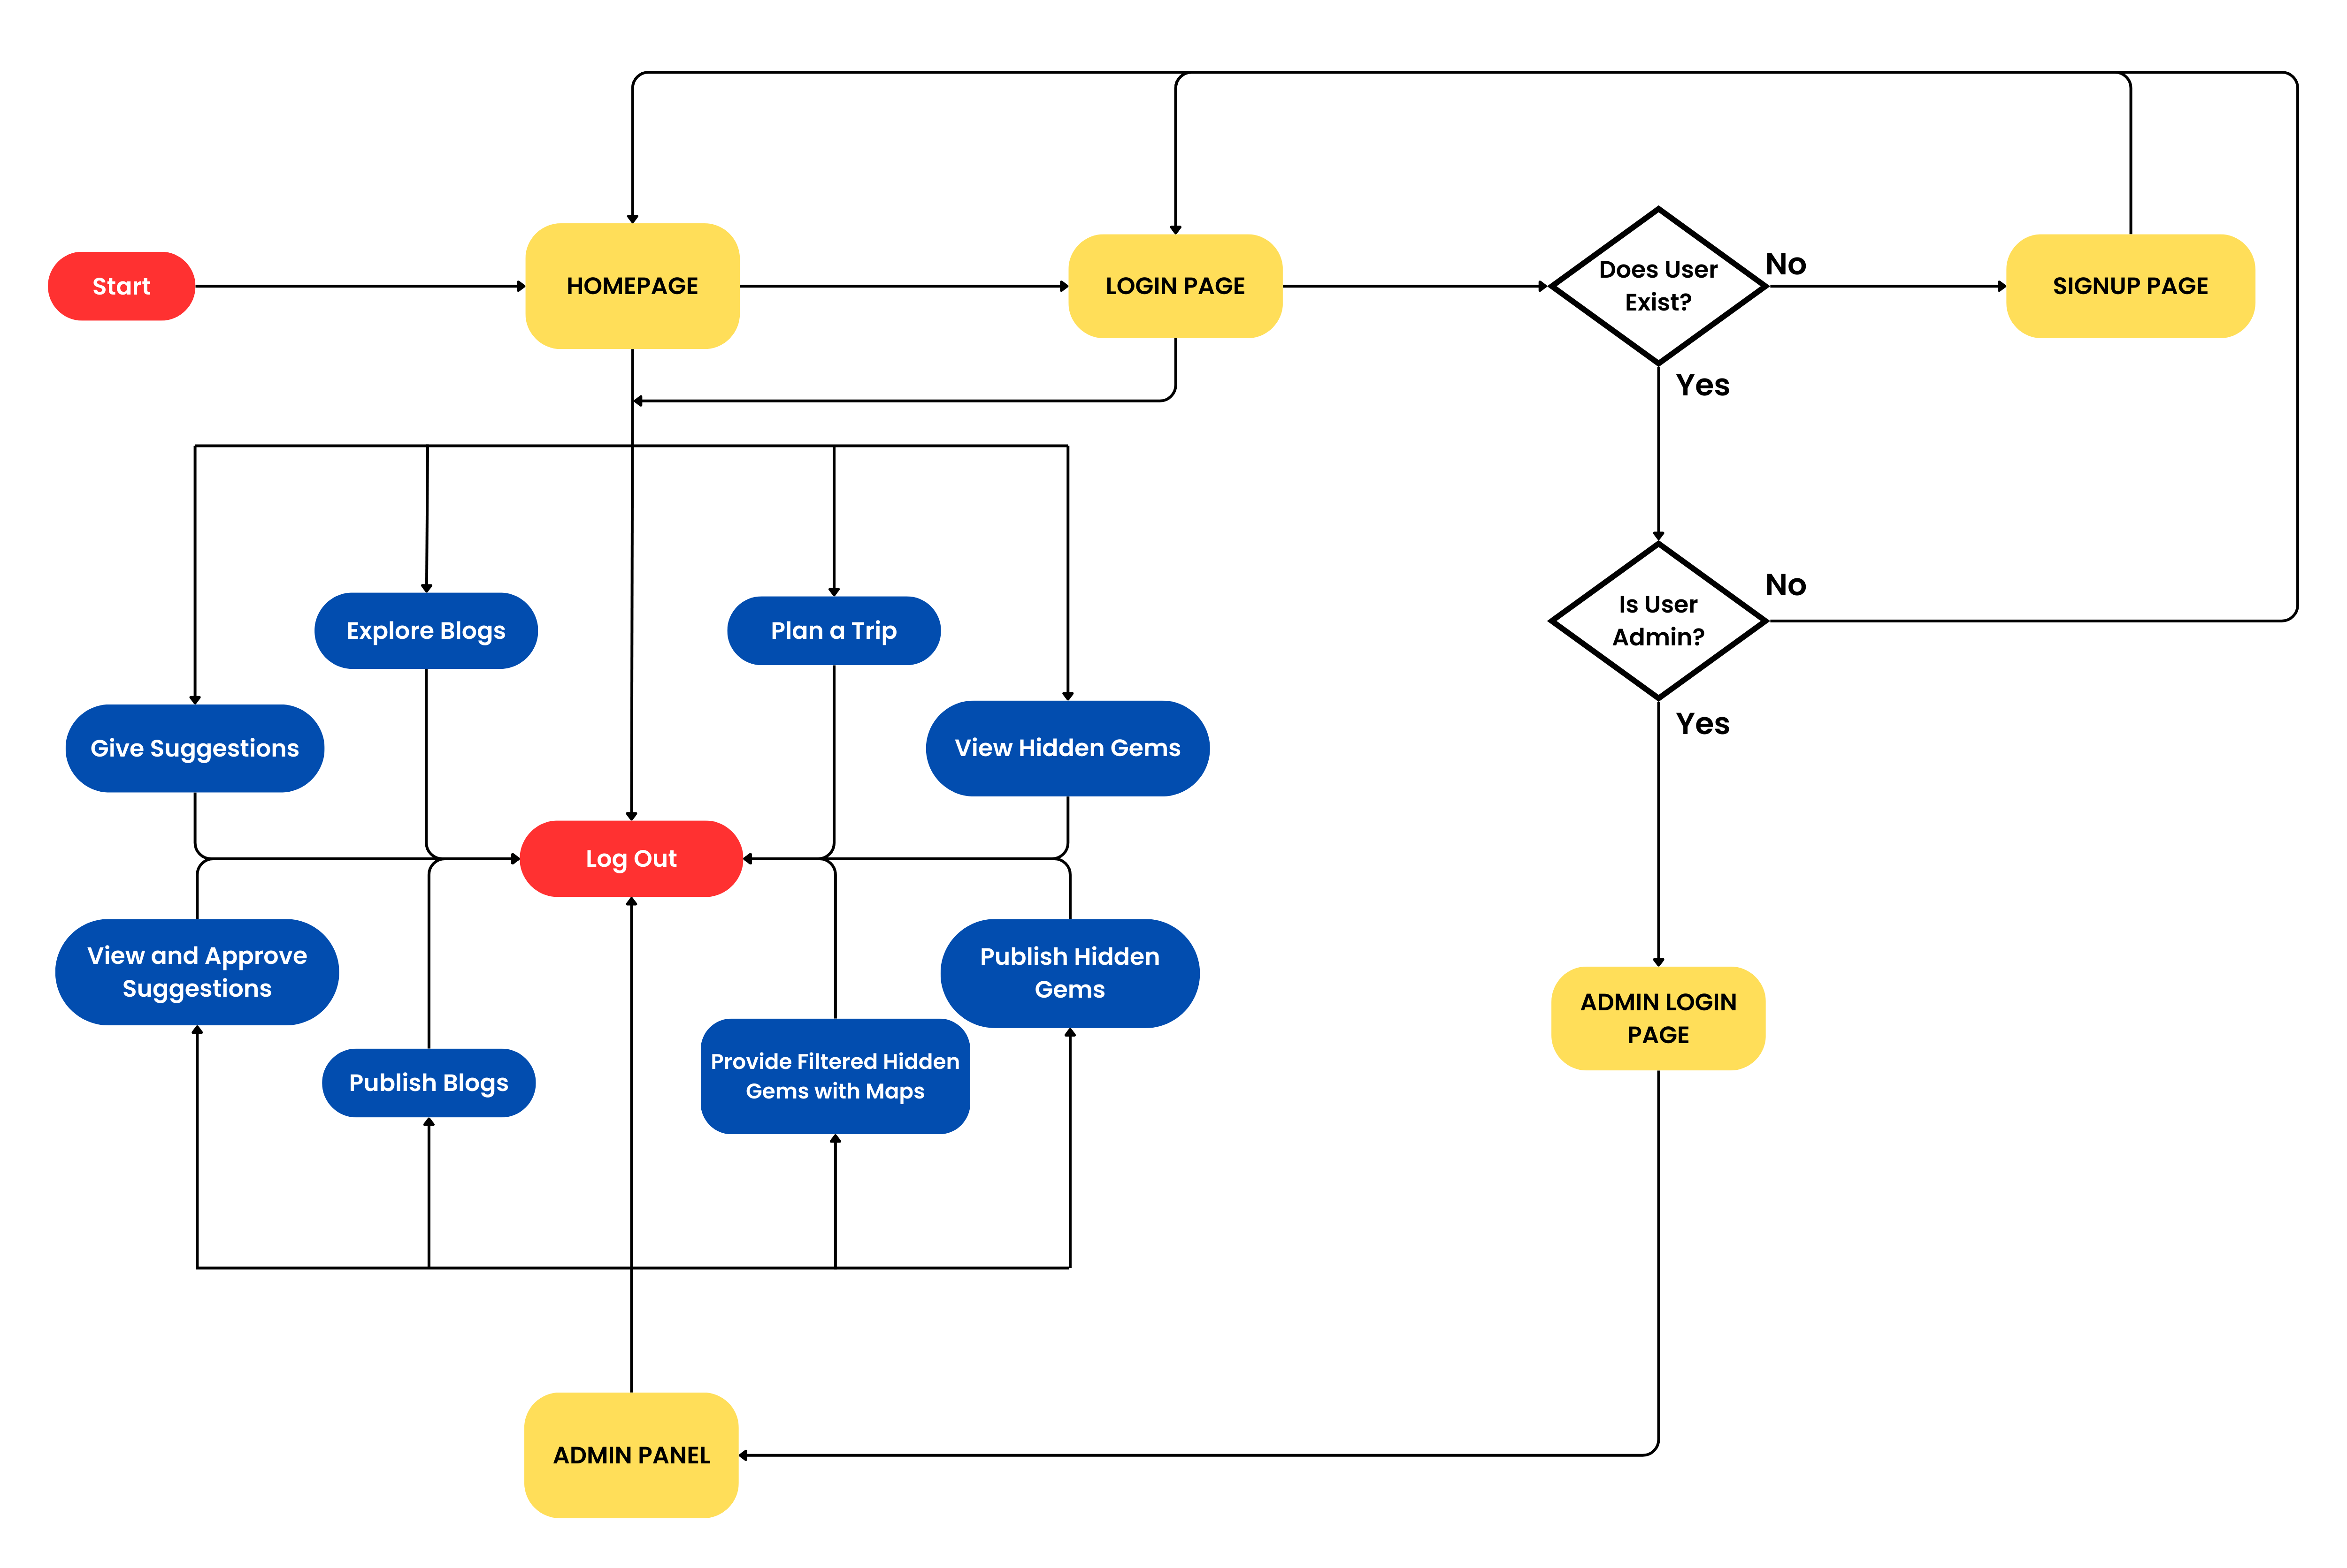
7. Block Diagram
Fig.7.1. Block Diagram

Slide 11
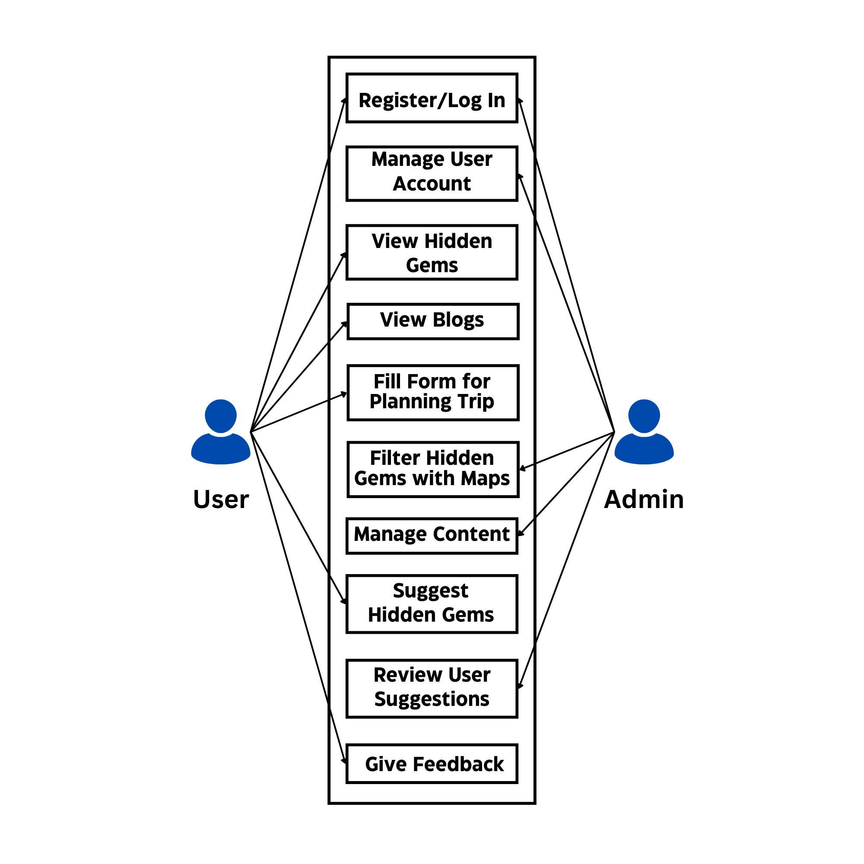
8. Use Case
Fig.8.1.Use Case Flow Diagram

Slide 12
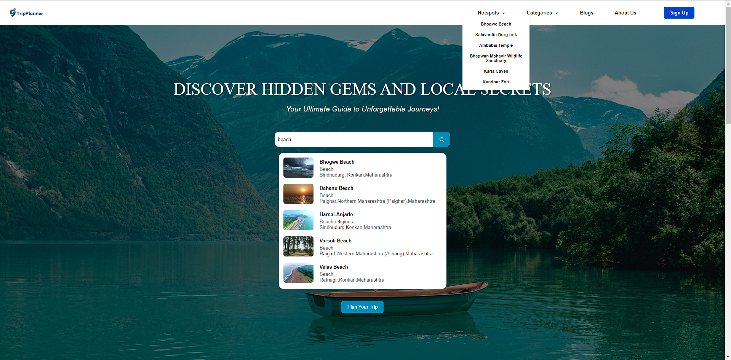
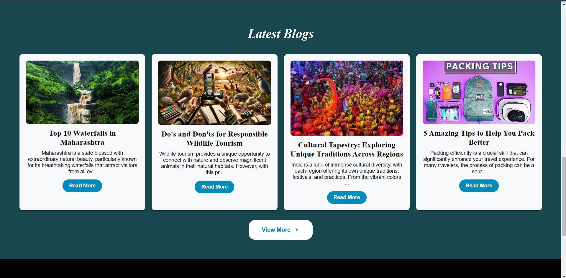
Result and Discussion
Search bar with dropdown suggestions, hotspots menu, and categories navigation.
Blog cards with images, titles, descriptions, and "Read More" and "View More" buttons.

Slide 13
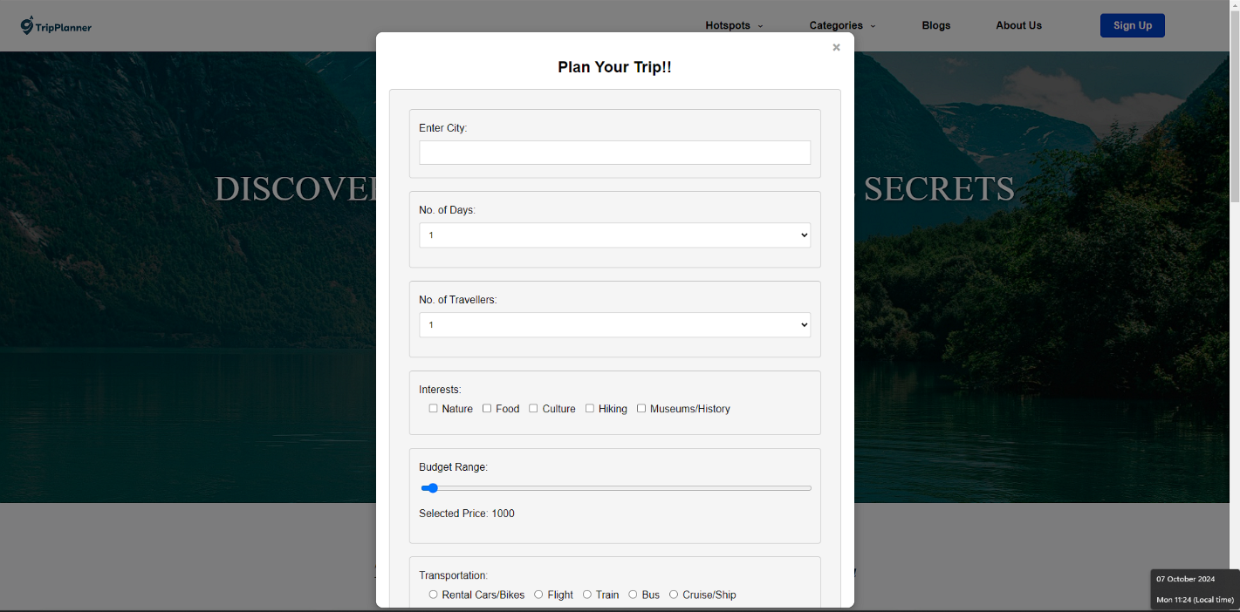
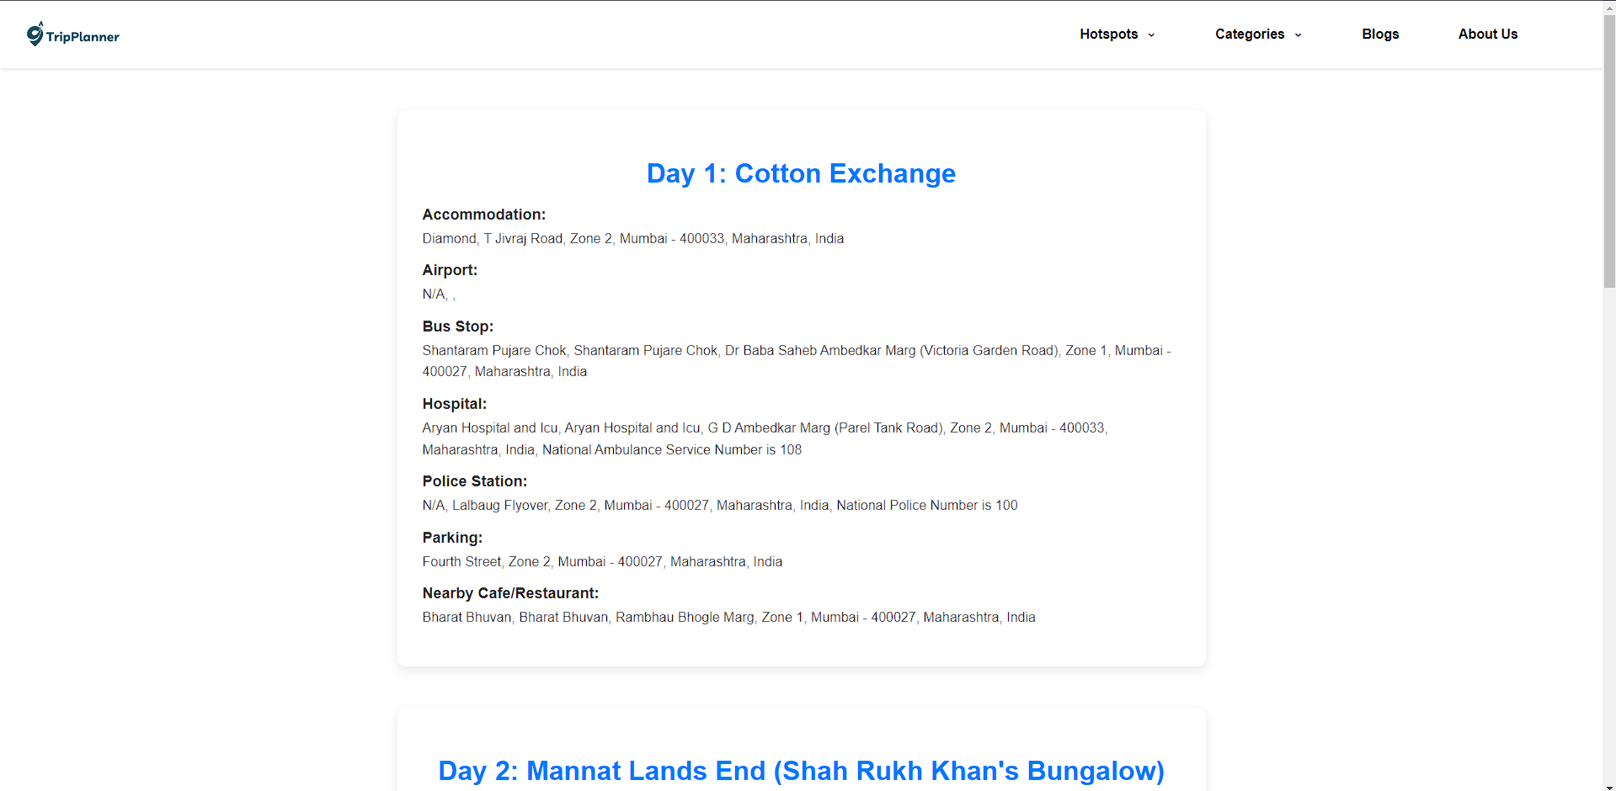
Result and Discussion
Trip planning form with fields for city, days, travelers, interests, budget range, and transportation options.
Trip itinerary planner with fields for destination, trip duration, number of travelers, interests, budget, and transportation choices.

Slide 14
Conclusion and Future Scope
In conclusion, the TripPlanner website is easy to use and helps travelers find local insights through personalized trip planning. The "Plan your trip" feature lets users discover destinations that match their interests which makes the journey smoother. The site also includes blogs and hidden gems, offering both popular spots and unique, lesser-known places. This makes it a valuable tool, providing a customized and enjoyable travel experience for everyone.
The future of TripPlanner includes expanding to cover more regions across India, like Rajasthan and Kerala, offering users more destinations and hidden gems. We will improve personalization, giving tailored recommendations based on interests like adventure or culture. With user participation through feedback and suggestions, TripPlanner is always improving. With these updates, TripPlanner will become the go-to platform for personalized and engaging travel planning across India.

Slide 15
References
[1] "Exploring the Use of Mobile Maps for Enhancing Travel Experience" Rebecca Davison, John Halloran, 2023
[2] "Crowdsourced travel itinerary recommendation with social interaction data" Sunil K. Gupta, et al., 2023
[3] "A personalized tourist recommendation system based on collaborative filtering and mobile services" Xueying Wang, Jing Yang, 2022
[4] "Tourism information personalization using recommendation systems" Charalampos Karapistoli, Dimitris Tzovaras, 2021
[5] "Location-aware recommendation system for tourism using hybrid approach" Minchen Wu, et al., 2021
[6] "An integrated system for personalized tourism route planning and location recommendation" Qing Cao, et al., 2021
[7] "Design and Implementation of Smart Tourism Application Using Hybrid Mobile Development" Vladimir R. Miroslav, et al., 2019
[8] "An intelligent mobile travel planning and recommendation system for tourists" Zhenxin Luo, et al., 2018

Slide 16
Thank You...!!

